Slide 1
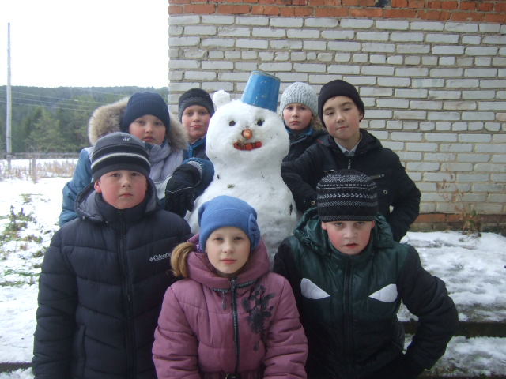
My name is Slava, my surname is Barishev and I am Vladimir Sidorov. We are in the 5 form of Poeduginskaya school. We would like to tell you about place we live in.

Slide 3
We are from Russia. The capital of Russia is Moscow. Moscow is famous for its Kremlin. When the New Year comes, there is a great New Year Tree in the Kremlin.

Slide 4
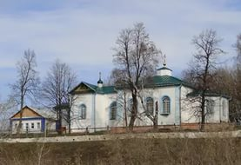
We live in Perm region. It is beautiful place with great forests, mountains, rivers. We are from Suksun region.

Slide 5
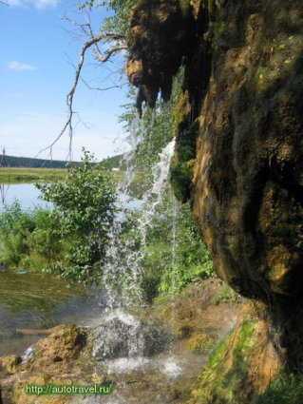
Our region is famous for river Silva , rainfall Plakun ,

Slide 6
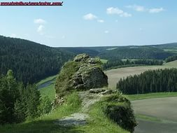
Grey mountain

Slide 7
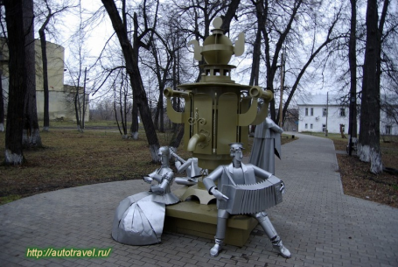
Мonument Samovar

Slide 8
We like our village, because we have a lot of fun here: we can swim in summer, ski and skate in winter, ride a bike and play sport in autumn and spring. We like Suksun region very much.

