Slide 2
My name is Andrey. I would like to tell you about the solar system. 1.We explore the Solar System. How many planets are there in the Solar system? 2. Which planet is the furthest - closest (дальше-ближе) to the Sun? 3. Is there life on other planets?

Slide 3
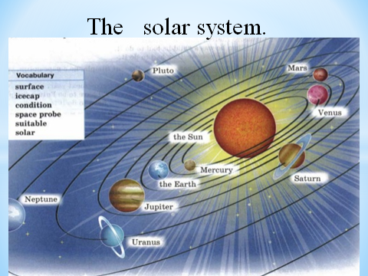

Slide 4
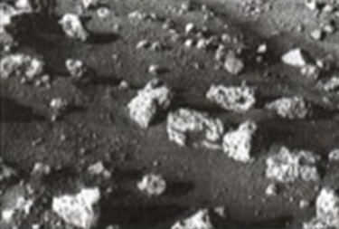
Russia explores space

Slide 5
1957: the first satellite Sputnik 1

Slide 6
1957: the first animal in Earth orbit, the dog Laika on Sputnik 2

Slide 7
